Slide 1

IoT-Based Fire Alert System using ESP32 and Blynk IoT
Presented by:
Atharva Tripathi
Anshika Pandey
Harshit Gautam
Deeksha Rawat
Department of Engineering, Babu Banarasi Das University

Slide 2


Introduction: Mitigating Fire Risks with Real-Time IoT
Fire accidents result in significant loss of life and property globally. Traditional systems often rely on localized alarms, which may not offer remote notification.
This project develops a cost-effective, real-time IoT-based fire detection system utilizing the ESP32 microcontroller, a flame sensor, and the Blynk IoT cloud platform for instant mobile notifications.
Our solution focuses on proactive alerting to minimize reaction time during fire incidents.

Slide 3




Core Objectives of the System
Instant Fire Detection
Real-time Mobile Alerts
Use a reliable flame sensor module to instantly detect the presence of fire based on infrared light.
Send instant, critical alerts directly to the user's smartphone via the highly effective Blynk IoT platform.
Local Auditory & Visual Alarm
Scalable & Cost-Effective
Activate a high-volume buzzer and a bright LED automatically upon detection to alert people nearby.
Deliver a low-cost, easily deployable solution that can be readily scaled for larger installations.

Slide 4




Essential Hardware and Software Components
The system relies on a minimal set of components for effective operation and connectivity.
ESP32 Microcontroller
Flame Sensor
The core processing unit with integrated Wi-Fi for cloud connectivity.
Detects the infrared spectrum emitted by fire, providing a digital signal.
Active Buzzer & LED
Blynk IoT Platform
Local alarm mechanisms for immediate audio-visual warnings.
Cloud service and mobile application for data exchange, alerts, and system management.

Slide 5
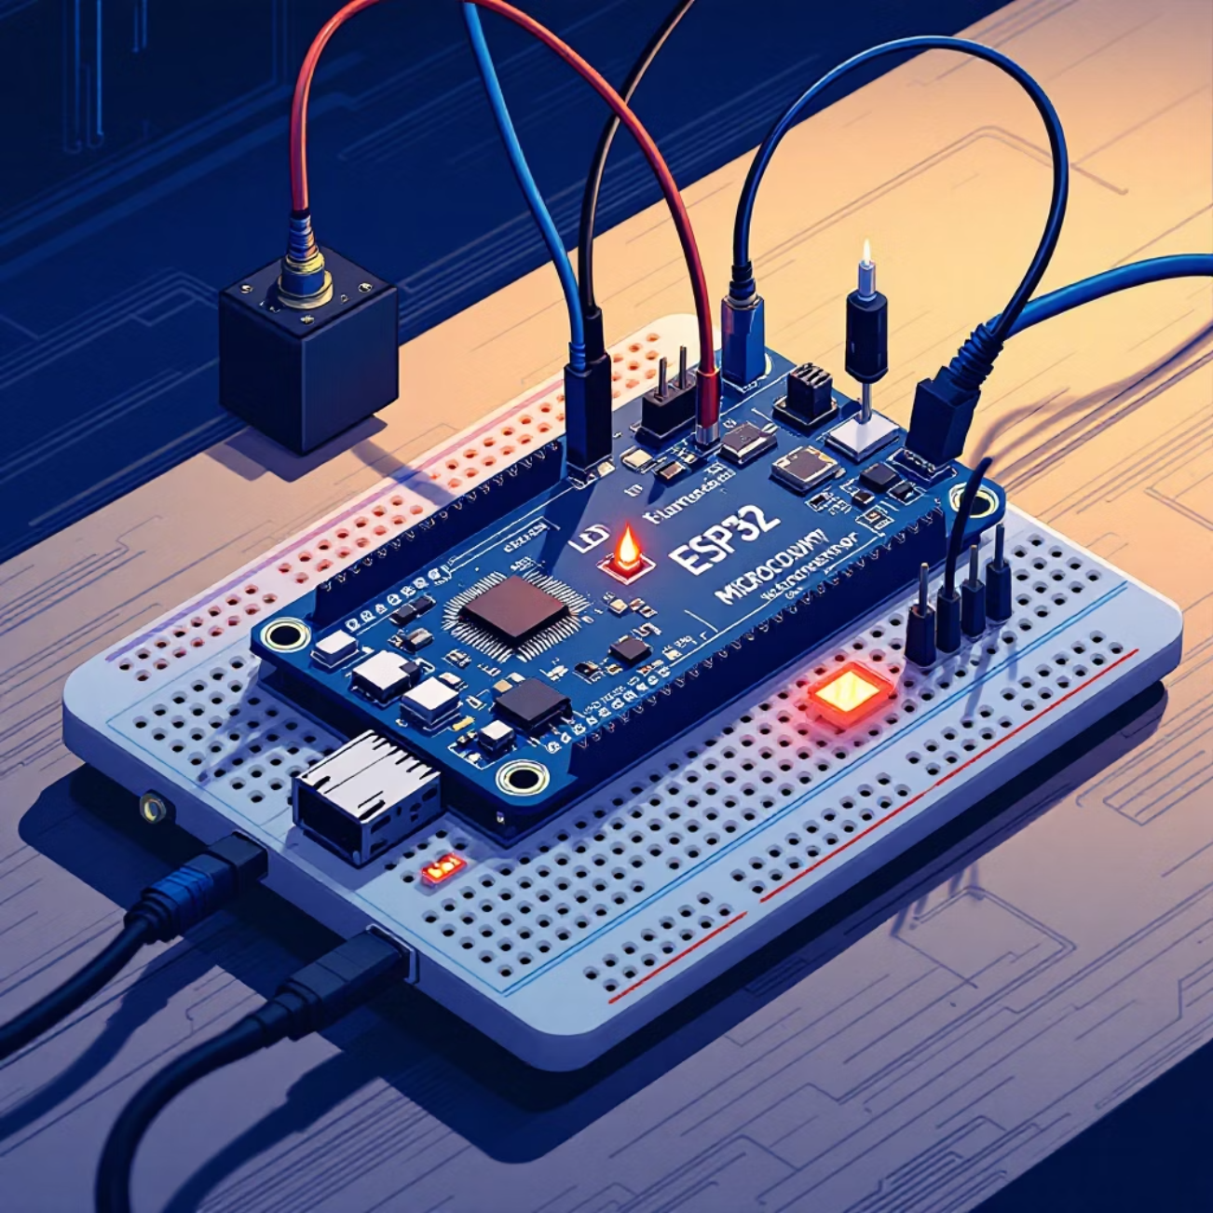
Physical Circuit Connections and Interface
Wiring Diagram Summary (Digital Pins)
Component
ESP32 Pin (GPIO)
Flame Sensor (Digital Out)
D4
Alarm LED
D2
Active Buzzer
D5
Power (VCC)
3.3V
Ground (GND)
GND
The ESP32 reads the sensor's digital output. A high signal indicates fire, triggering the local outputs (LED/Buzzer) and the remote alert (Blynk).

Slide 6

System Architecture: Data Flow and Connectivity
The system operates in a linear progression, ensuring swift detection and reliable transmission of critical status information.
Flame Sensor
ESP32 Gateway
WiFi Link
Blynk Cloud
The ESP32 serves as the gateway, collecting binary data from the flame sensor, encapsulating it, and securely pushing it to the Blynk Cloud over the local Wi-Fi network.

Slide 7





Step-by-Step Working Principle
Detection
The flame sensor, sensitive to infrared light at 760 nm to 1100 nm, instantly detects the signature of a fire source.
Signal Processing
The ESP32 continuously monitors the sensor's digital pin using a simple digitalRead() function.
Local Response
If a fire signal is confirmed, the ESP32 sets the digital pins for the LED (D2) and Buzzer (D5) to HIGH, activating the local alarm.
Remote Alert
Simultaneously, the ESP32 communicates with the Blynk Cloud to execute a Blynk.logEvent(), triggering a push notification to the user's mobile device.
System Reset
Once the threat is removed and the sensor is clear, the system automatically resets the alarm outputs and reverts to continuous monitoring mode.

Slide 8


Code Implementation Highlights
Connectivity: Requires pre-configured Wi-Fi SSID, password, and a unique Blynk Auth Token to establish secure communication with the cloud.
Sensor Monitoring: The main loop repeatedly checks the state of the flame sensor input pin.
Event Logging: Upon detecting fire, the code triggers both local outputs and uses Blynk.logEvent("fire_alert") to send the specific notification.
Efficiency: Using digital read is computationally light, allowing the ESP32 to maintain constant cloud connection with minimal latency.
For a robust system, the Blynk server can also be configured to send emails or SMS alerts as a secondary notification channel.

Slide 9





Key Benefits and Potential Applications
System Advantages
Targeted Applications
Instant Global Alerting
Notifications reach the user regardless of location, provided they have an internet connection.
Affordable Hardware
Low component cost makes this solution accessible for makers and mass deployment.
Simple Integration
Easy connection and setup with the Blynk IoT platform and minimal coding required.
Low Power Consumption
The ESP32 is power-efficient, suitable for scenarios where continuous monitoring is required.
Residential Homes and Apartments
Small-to-Medium Enterprises (Offices)
High-Value Areas (Data Centers & Server Rooms)
Public Buildings (Schools and Hospitals)

Slide 10

Conclusion: An Effective Foundation for Smart Safety
Early Detection. Instant Action.
The IoT-based Fire Alert System successfully leverages the power of the ESP32 and the Blynk platform to deliver crucial early fire detection and immediate mobile alerts.
Future Enhancements
The system is highly extensible. Future iterations could integrate additional sensors (e.g., MQ-2 for smoke/gas, DHT11 for temperature) and introduce machine learning models to reduce false alarms and increase overall reliability.

